Slide 1

Team Details
Team name: Code Craft
Team leader name: Soumik Samanta
Problem Statement: Open Innovation

Slide 2

Brief about your solution and problem statement addressing : -
Upload a snapshot of your plastic waste through the platform.
AI & ML technology evaluates the quality & quantity of the plastic.
Cashback points are generated based on the assessment.
An automated system tracks the user’s location and assigns the nearest trader for pickup. Users earn cashback points after selling plastic waste, redeemable for offers and prizes on third-party apps.
The platform also allows users to purchase recycled plastic products.
The problem addresses inefficient plastic waste management and the lack of proper tracking and recycling systems.
It aims to reduce plastic pollution by promoting reuse and responsible disposal through technology.

Slide 3
Opportunities
How different is it from any of the other existing ideas?
Tracking – Identifying where plastic waste comes from, how much is generated, and where it ends up.
Reducing – Using the tracked data to reduce plastic usage at the source (shops, homes, schools).
Reusing – Converting collected plastic into reusable or eco-friendly products instead of throwing it away.
How will it be able to solve the problem?
AI-based identification is used to identify biodegradable plastic waste through image screening, evaluate its quality and quantity, and make it reusable.
Users earn cashback points by selling plastic waste, which can be redeemed as discounts, coupons, deals, or rewards across partner platforms.
The nearest trader is assigned for waste collection using path optimization, and users can also buy low-cost recycled and DIY products made from reusable plastics via the app or website.

Slide 4
List of features offered by the solution
A multilingual android and web-based platform, based on 32 different languages, which serves the term “Waste Management” a proper and efficient structure
Providing a secure employment to those vendors who had unstable sources of income and were collecting recyclables door-to-door.
Automatic generation of cashback points according to the quality and quantity of plastic wastes through Machine Learning and Artificial Intelligence.
Once a trader is allocated to a user, an Al-powered 24/7 hotline chatbot is available, as well as real-time tracking of the trader's location.
By enabling an additional option to incorporate our platform at the end of their online bill, every e-commerce website will find it easier to recycle the plastics used in their product packaging.
Users can donate a set amount towards the planting of a tree at the end of each purchase of recycled plastic items, the geographical location of which will be shared with the user later.

Slide 5
Google Technologies used in the solution
Powered by Google
Google Cloud Vision – Image recognition and screening of plastic waste
Artificial Intelligence & Machine Learning – Classification, quality analysis
and reward calculation
AI & Machine Learning
TensorFlow
Keras
OpenCV
Python
NumPy
Mobile & Web Development
Flutter
Kotlin
Android
React
Backend & Data Management
Node.js
MongoDB
Firebase
SQL

Slide 6
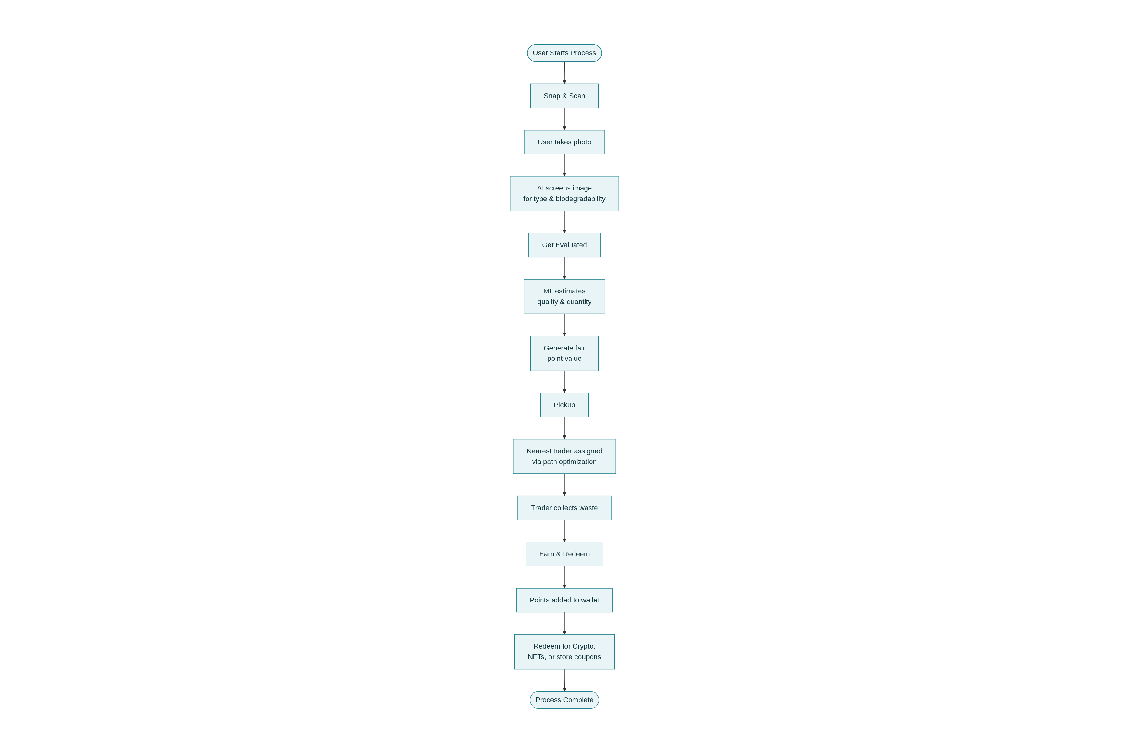
Process flow diagram or Use-case diagram

Slide 7
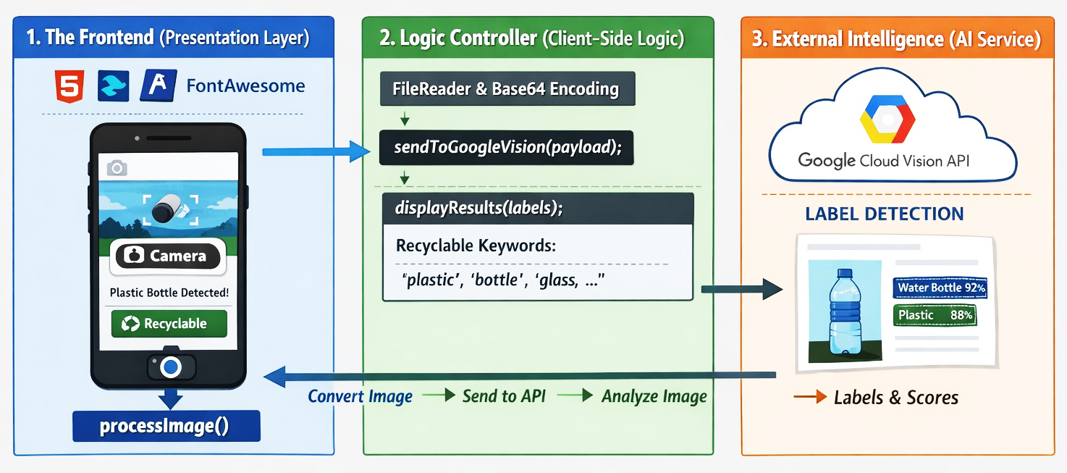
Architecture diagram of the proposed solution

Slide 8
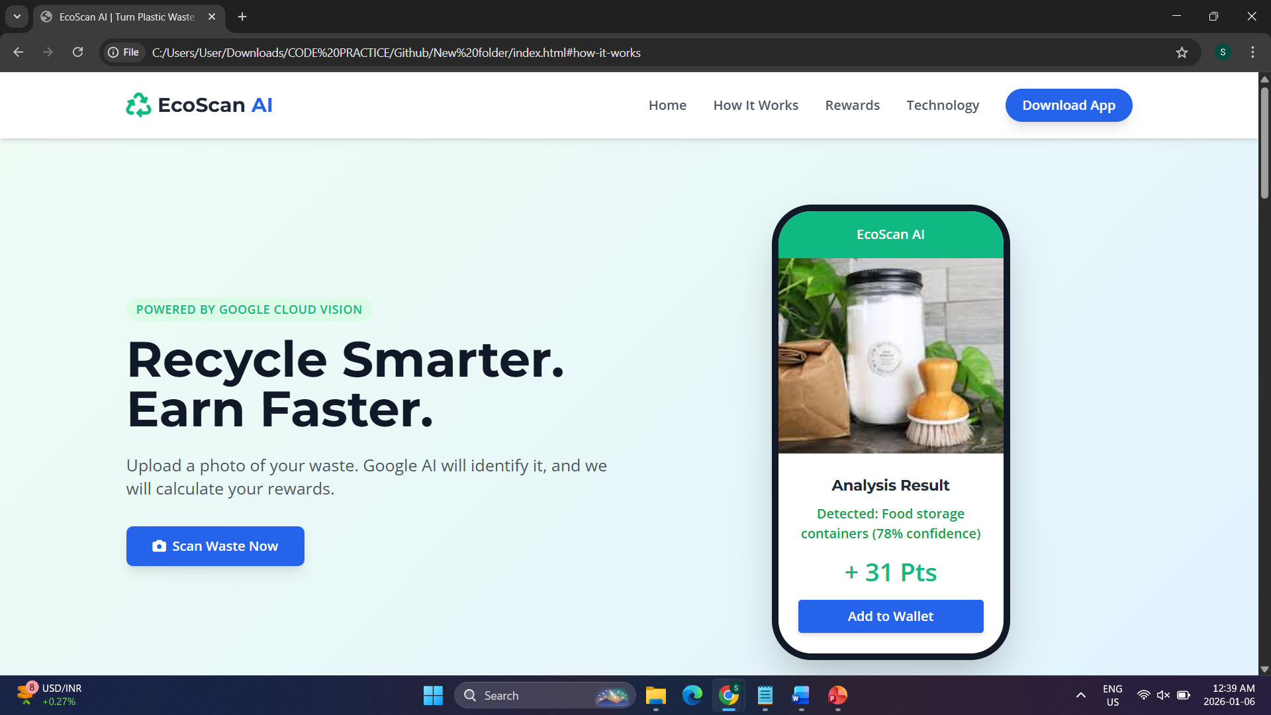
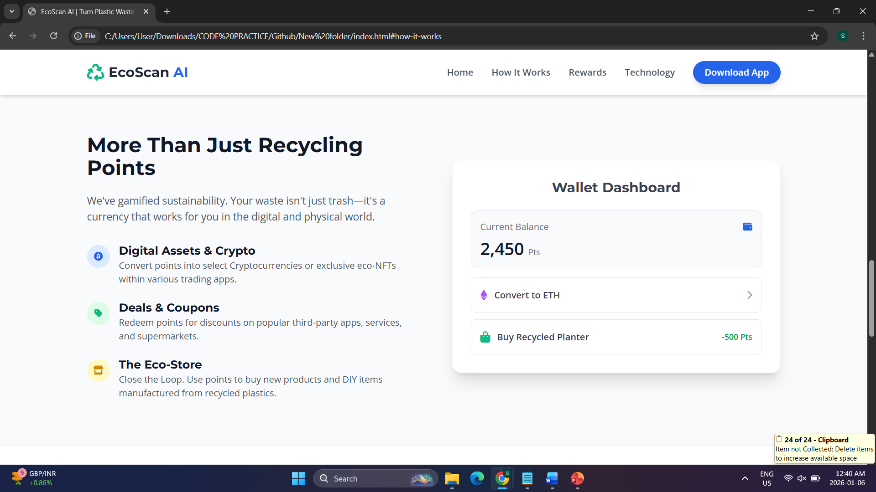
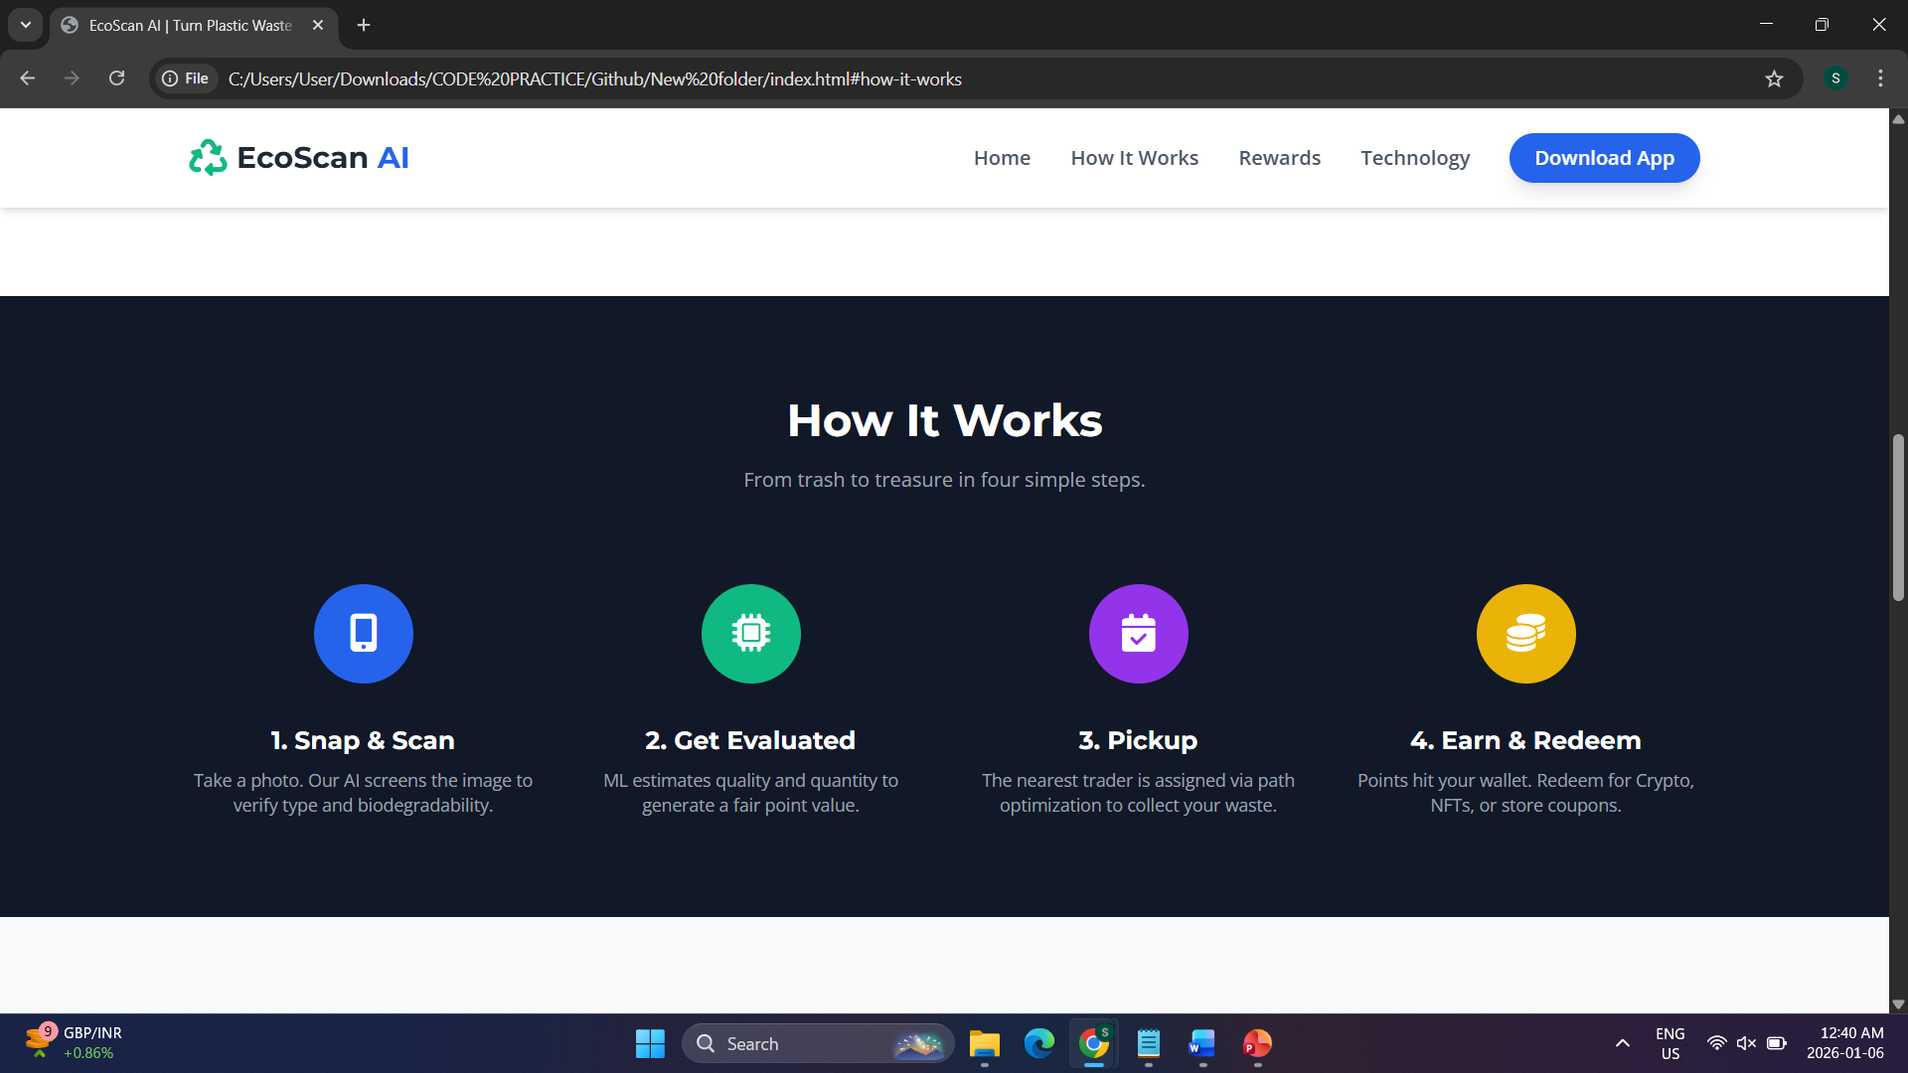
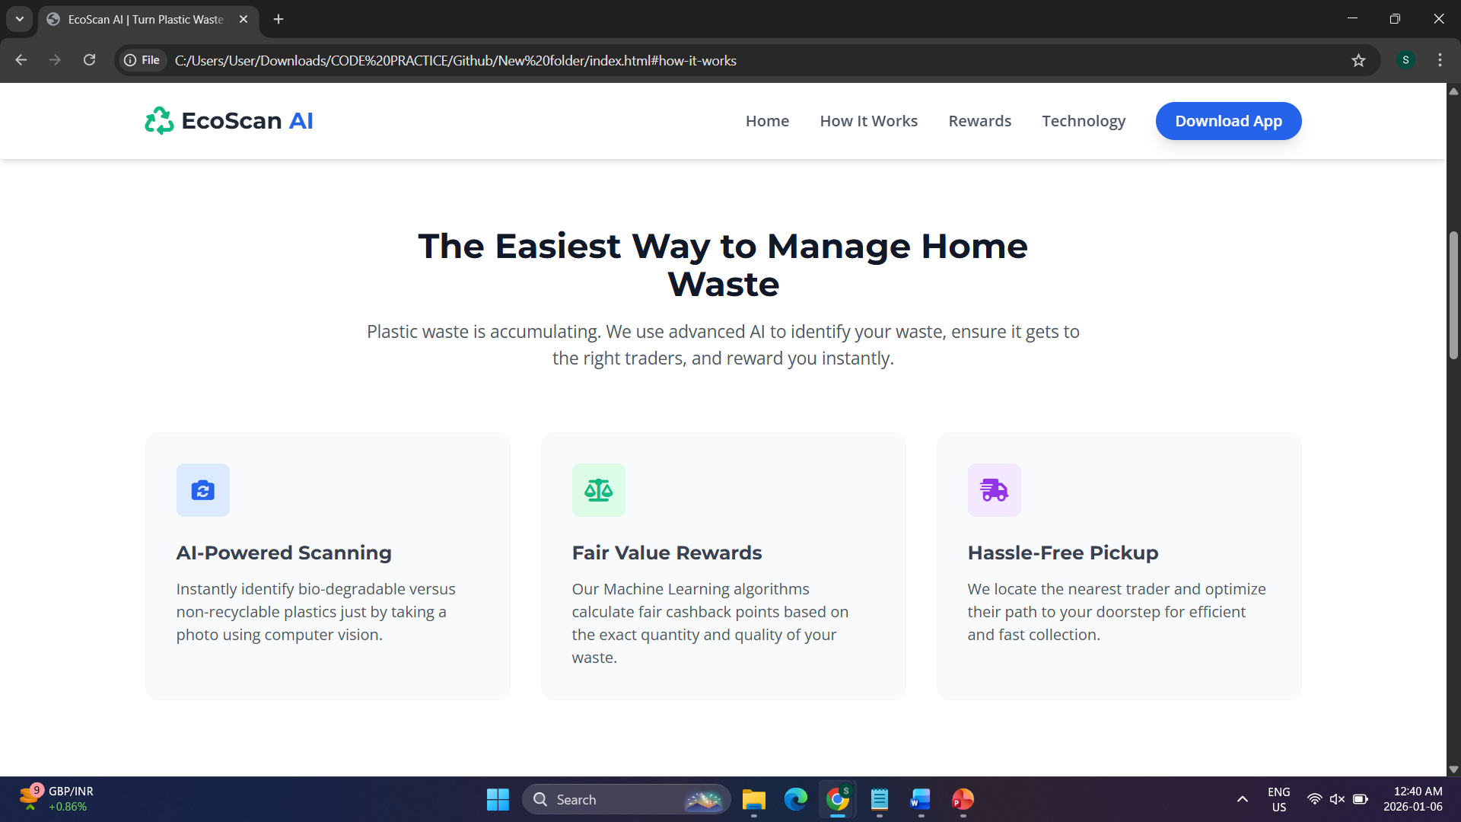
Snapshots of the MVP

Slide 9
Additional Details/Future Development (if any)
Enhanced backend implementation for real-time tracking, secure data handling, and smooth system operations.
Improved AI & ML models for accurate plastic identification, quality analysis, and reward calculation.
Scalable system to support more users, locations, and higher volumes of plastic waste.
Future integration with smart bins, analytics dashboards, and expanded partner rewards.

Slide 10
Provide links to your:
GitHub Public Repository
https://github.com/SoumikSamanta123/Garbage-AI-System
Demo Video Link (3 Minutes)
https://drive.google.com/file/d/1K2B8-xdVFsmdPbvu1vtjph80XckIDqy6/view?usp=drive_link
MVP Link
https://ecoai-red.vercel.app/

